Slide 1
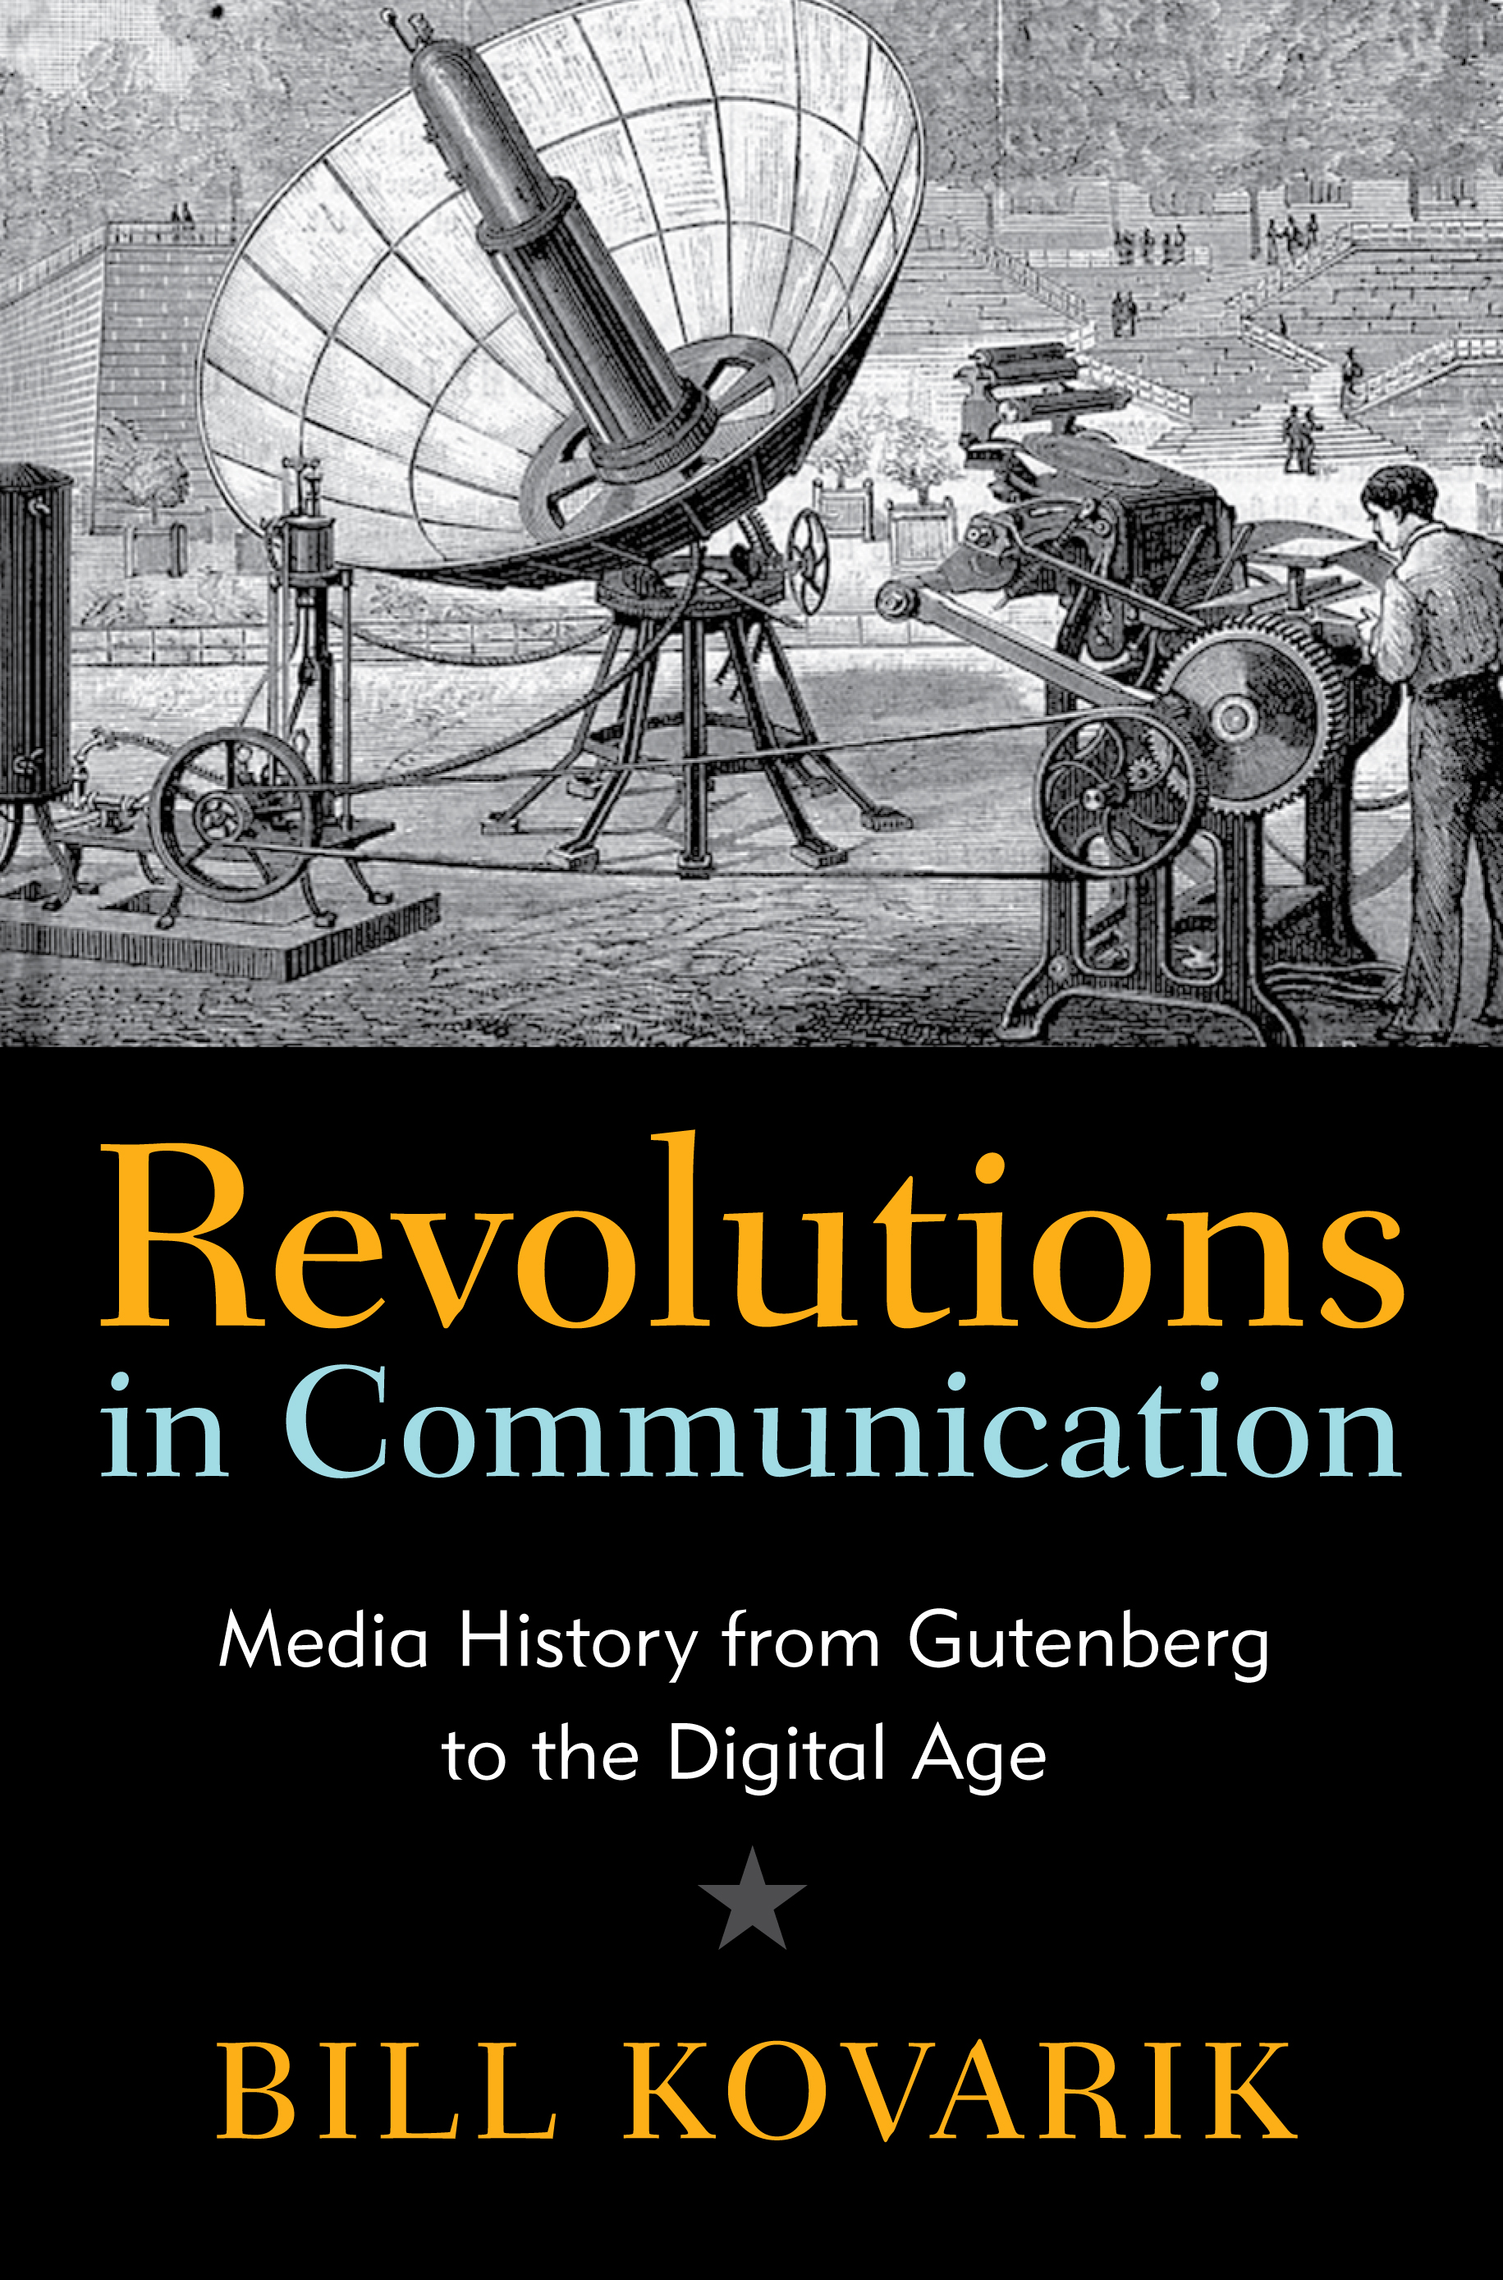
Short lectures in Media History
Chapter Twelve
Global Culture
www.revolutionsincommunication.com

Slide 2
