Slide 1
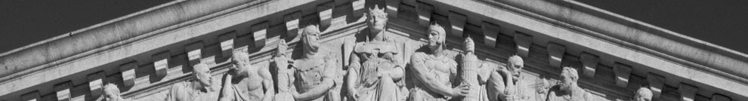
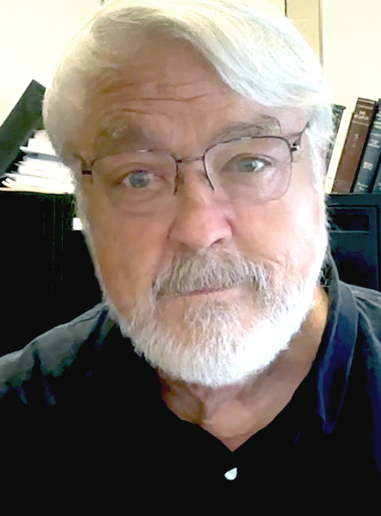
Communication Law & Ethics
RU COMS 400 - 500 UNIT 1 Introduction
Class web site: https://revolutionsincommunication.com/law
Prof. Bill Kovarik, PhD
wkovarik@radford.edu

Slide 2
COMS 400-500 course
Required for Media majors
Fills Bachelor of Sci req for Comm majors
Recommended for grad students
Open lectures / some classes will be recorded via zoom
T-Th 3:15 – 4:45 HH 1016 Jan 13 – Ap 23
MT & Final exams are open book online
Course closes May 1.

Slide 3
Introduce a class member
Take five minutes to talk with one or two others sitting near you.
Write down name, hometown, major & concentration, career goal.
Briefly - What issues in media law you’ve heard about or want to know more about.

Slide 4
Current issues
What recent concerns have you noticed about media law?

Slide 5
Current issues

Slide 6
Special focus Spring 2026
Technology & media law
Europe & US conflicts over regulating the internet & social media
Artificial intelligence, libel & copyright
Advertising regulation, Oxycontin, and Purdue Pharma (a local issue)
Regulating “Greek” signs (another local issue)

Slide 7
Main resources
D2L learn.radford.edu
Syllabus via email, D2L
Day to day class notices via email
Online textbook:
https://revolutionsincommunication.com/law/
Research – esp. law reviews in Nexis https://libguides.radford.edu/az/databases?a=n
Additional readings linked from textbook

Slide 8
On track: overall
Read the textbook revolutionsincommunication.com/law
12 sections / one per week
Practice quiz at the end of each section
Take the section quiz on D2L
Assignments, reading & viewing responses
Turn in A-0.1 and A-1 by next week
Put your last name on the file and in the text when you turn it in on D2L
Ex: Yourname.Assn1.docx

Slide 9
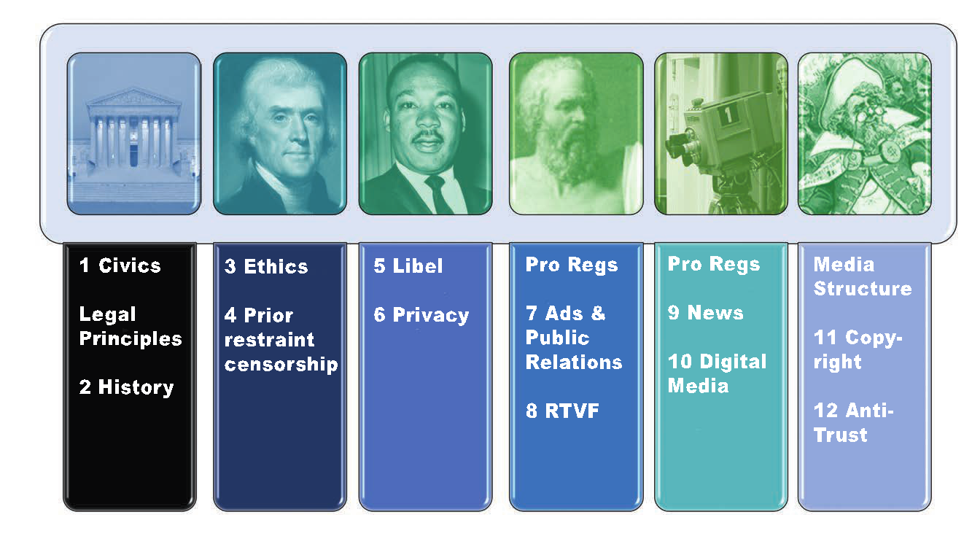
Six main content areas

Slide 10
What is law? (formal definitions)
"A body of rules of action or conduct prescribed by a controlling authority." -- Black's law dictionary
Constitutional law defines the role, powers, and structure of the executive, the legislature (or parliament), and the judiciary; as well as the basic rights of citizens
Law balances individual rights against other priorities such as public safety

Slide 11
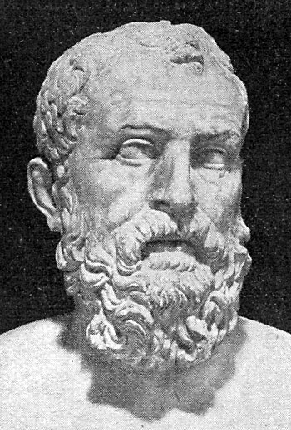
What is law?
Anacharsis … laughed at Solon for imagining that the dishonesty and covetousness of his countrymen could be restrained by written laws, which were like spiders' webs, and would catch, it is true, the weak and poor, but easily be broken by the mighty and rich.
To this Solon rejoined that men keep their promises when neither side can get anything by the breaking of them; and he would so fit his laws to the citizens, that all should understand it was [better] to be just than to break the laws.
-- Plutarch, Parallel Lives, c. 100 A.D.
Notes:
This story brings up an important question as we study law – Should the laws fit human behavior, or should they seek to improve it?

Slide 12
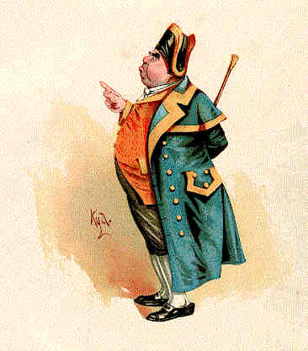
What is law?
Judge: "You are the more guilty of the two, in the eye of the law; for the law supposes that your wife acts under your direction.”
Mr. Bumble: "If the law supposes that ... the law is an ass — an idiot. If that's the law, the law is a bachelor; and the worst I wish the law is that his eye may be opened by experience."
-- Charles Dickens, Oliver Twist
Notes:
Beadle, sometimes spelled "bedel", is an official of a church or synagogue who may usher, keep order, make reports, and assist in religious functions; or a minor official who carries out various civil, educational, or ceremonial duties.
The term has pre-Conquest origins in Old English, deriving from the Old English bydel ("herald, messenger from an authority, preacher"), itself deriving from beodan ("to proclaim", which has a modern descendant in the English verb bid).^{[1]} In Old English it was a title given to an Anglo-Saxon officer who summoned householders to council. It is also known in Medieval Latin as bedellus.

Slide 13
Why study media law ?
Understand how free countries balance rights
Professionals need to know how to avoid doing harm and …
To know that the legal system protects ethical public communication, free press and free markets
That freedom of speech protects unpopular points of view as well as popular ones
That free speech issues can be far away, but they can also be close to home
Notes:
"To announce that there must be no criticism of the president or that we are to stand by the president right or wrong, is not only unpatriotic and servile, but it is morally treasonable to the American public." - President Theodore Roosevelt

Slide 14
How to study media law
Critical thinking
Deductive reasoning / by analogy
from a general rule (court decision) to a specific conclusion (how the rule should be applied in a particular case).
Inductive reasoning / from specific cases to general rules (jurisprudence)
Epistemology / use authoritative & expert sources

Slide 15
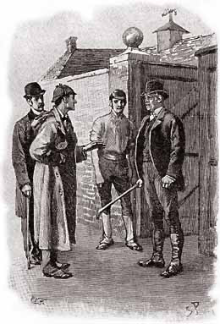
Deductive reasoning
Sherlock Holmes used general theories to develop specific conclusions. In the case of Silver Blaze, a dog did not bark when a crime took place.
Holmes deduced that the dog probably knew the person who was
committing the crime.

Slide 16
Reasoning by analogy
Like deductive reasoning -- similar facts or principles or court decisions can help form a general rule that is likely to lead to similar conclusions. This is important when law students write briefs and cite cases to support a legal argument.
Example — When a civil lawsuit for libel is filed in any US court, the facts of that case are compared with standards set in the New York Times v. Sullivan case (1964).

Slide 17
Inductive reasoning
From specific to general — Lawyers and judges often use inductive reasoning to analyze specific cases and then develop a general legal rule or doctrine.
Example: In Moody v Netchoice, 2024, the Supreme Court opinion pointed to many previous cases to reinforce the state actor doctrine.

Slide 18
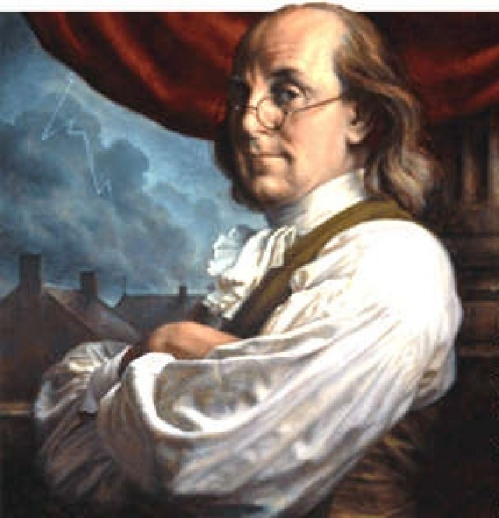
Ben Franklin
Endorsing the Constitutional convention in 1787
I wish … every Member of the Convention, who may still have Objections to it, would with me on this Occasion doubt a little of his own Infallibility …

Slide 19
Chapter 1
Studying the US First Amendment
Human rights worldwide
International legal systems
Basic civics
Distinguishing media law
Concepts & terms
Example: Smith v Jones
First Amendment Jurisprudence
International media law

Slide 20
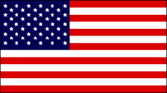
1.1 The First Amendment
Congress shall make no law
respecting an establishment of
religion, or prohibiting the
free exercise thereof; or abridging the freedom of speech, or of the press; or the right of the people peaceably to assemble, and to petition the government for a redress of grievances.

Slide 21
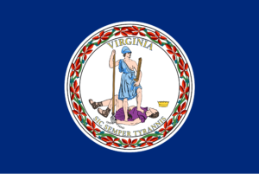
Virginia Constitution, 1776
That all men are by nature equally free and independent and have certain inherent rights, of which, when they enter into a state of society, they cannot, by any compact, deprive or divest their posterity; namely, the enjoyment of life and liberty, with the means of acquiring and possessing property, and pursuing and obtaining happiness and safety…
Notes:
We’re all familiar with the First Amendment to the US Constitution, and it’s a good place to start a class on media law. Notice there are six major clauses – TWO for religion at the beginning – Two for speech and press – and two for assembly and petition.

Slide 22
Virginia Constitution, 1776
That all power is vested in, and consequently derived from, the people, that magistrates are their trustees and servants, and at all times amenable to them…
Notes:
We’re all familiar with the First Amendment to the US Constitution, and it’s a good place to start a class on media law. Notice there are six major clauses – TWO for religion at the beginning – Two for speech and press – and two for assembly and petition.

Slide 23

The European Convention for the Protection of Human Rights and Fundamental Freedoms, Article 10
Everyone has the right to freedom of expression. This right shall include freedom to hold opinions and to receive and impart information and ideas without interference by public authority and regardless of frontiers…

Slide 24

Universal Declaration of Human Rights, Article 19
Everyone has the right to freedom of opinion and expression; this right includes freedom to hold opinions without interference and to seek, receive and impart information and ideas through any media and regardless of frontiers.

Slide 25
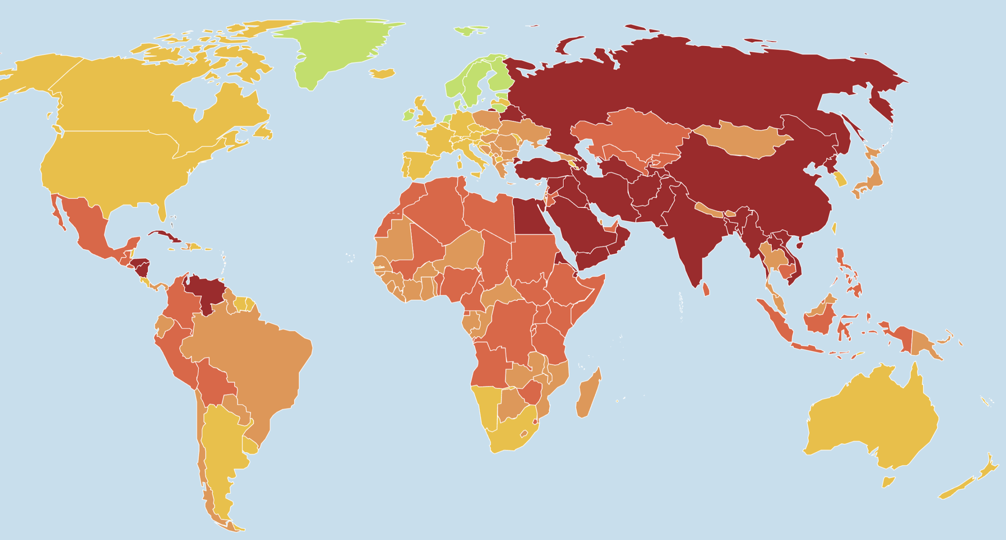
1.2 Human rights
RSF.org World Press Freedom Index

Slide 26
US is # 45 on the freedom index
Trump attacks on press as “enemies of the people” pushed US rating down
Also arrests of journalists covering demonstrations
Lack of shield laws to protect confidential sources, and searches and confiscations of journalists’ equipment
Other press freedom barriers persist

Slide 27
Saudi Arabia is # 170
No free media, political parties, unions, etc
Journalists and citizens routinely jailed, sometimes executed, for any criticism
Jamal Khashoggi assassination one of many
Blasphemy, insulting religion, "inciting chaos", "jeopardizing national unity" and "undermining the image and reputation of the king and the state" are typical charges in secret courts.
Hundreds of people are executed every year for crimes ranging from murder to attending pro-democracy protests. Trials and executions are kept secret, even from relatives.

Slide 28
China is 179 / 180
“The world’s largest prison for journalists”
Kunchok Jinpa, a leading media source of information about Tibet, died in February 2021 as a result of mistreatment in prison
Liu Xiaobo, a Nobel peace laureate, and Yang Tongyan, dissident blogger, died in prison 2017
Secret trials and forced confessions
Arrests of editors and journalists in Hong Kong 2022 – 23
Forces trading partners like Google, Apple, & satellite companies, to submit to state censorship
RSF calls China a “predator of press freedom.”
Notes:
China continues to be the world’s biggest jailer of press freedom defenders, with more than 115 currently detained, often in conditions that pose a threat to their lives, just as Liu Xiaobo, a Nobel peace laureate and winner of the RSF Press Freedom Prize, and Yang Tongyan, a dissident blogger, did in 2017

Slide 29
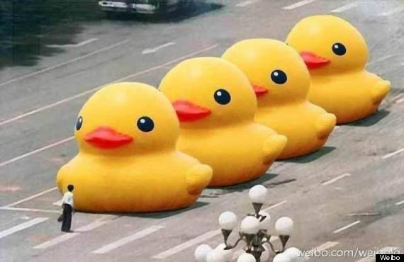
How China celebrates May 35th

Slide 30
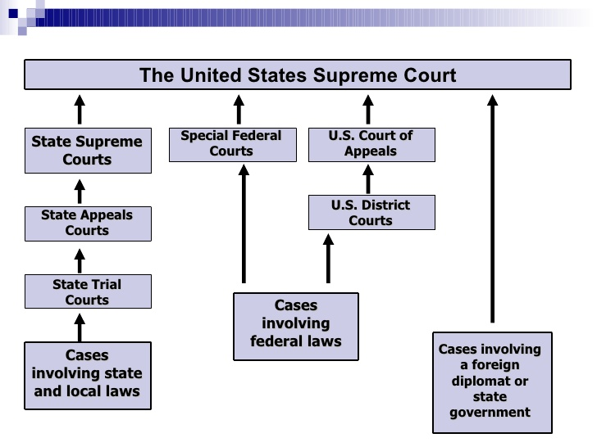
1.3 Structure of courts
Notes:
Freddie / Balt

Slide 31
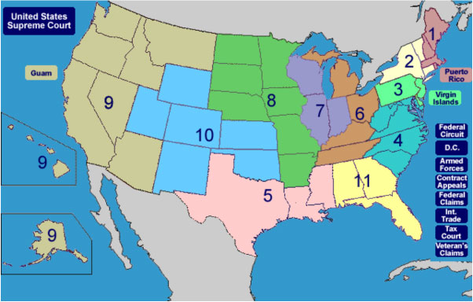

Slide 32
State courts
Virginia: circuit vs district court.
Other states: Upper & lower, county & municipal, etc.
Circuit courts - major criminal and civil cases
District courts - traffic, misdemeanors, small claims, drug courts, etc
State verdicts may be appealed through state appeals courts and then to a state supreme court

Slide 33
Federal vs state
Federal courts have trial and appeals courts and usually involve charges concerning federal laws
Federal courts may also try cases with participants from different states (diversity jurisdiction)
Federal verdicts may be appealed through federal appeals courts and then to the US Supreme Court
The US Supreme Court also hears cases appeals from state supreme courts

Slide 34
Five sources of law
Statutory (Congress, state legislatures)
Regulatory (Executive agencies)
Common (Judiciary)
Reviews statutory and regulatory law
Equity (injunctions, divorce, probate)
Chancery Court, redress of Common Law complaints
Constitutional
General term for legal questions about balancing individual rights and the structure of the government
Notes:
Common -- historical
Equity -- A body of civil law concerned with doing justice where money is inadequate or inappropriate as a remedy. Examples of equitable actions include divorce and injunctions. Equity cases are handled by circuit courts. (Originally, a King's corrective prerogative, justice administered according to ideas of fairness, not strict adherence to precedent / stare decisis )

Slide 35
World legal systems
Common law: United States, UK, Ireland, Canada, Australia
Civil: France, Germany, most European and Latin American nations
Traditional: India
Religious: Arab nations, Israel

Slide 36
Common vs Civil Law
Common: Judge is umpire in a plaintiff vs defendant courtroom system
Civil: Judge(s) lead court inquiry like prosecutors
Common: Judges review laws based on Constitution or legal precedent
Civil: Judges apply laws directly

Slide 37
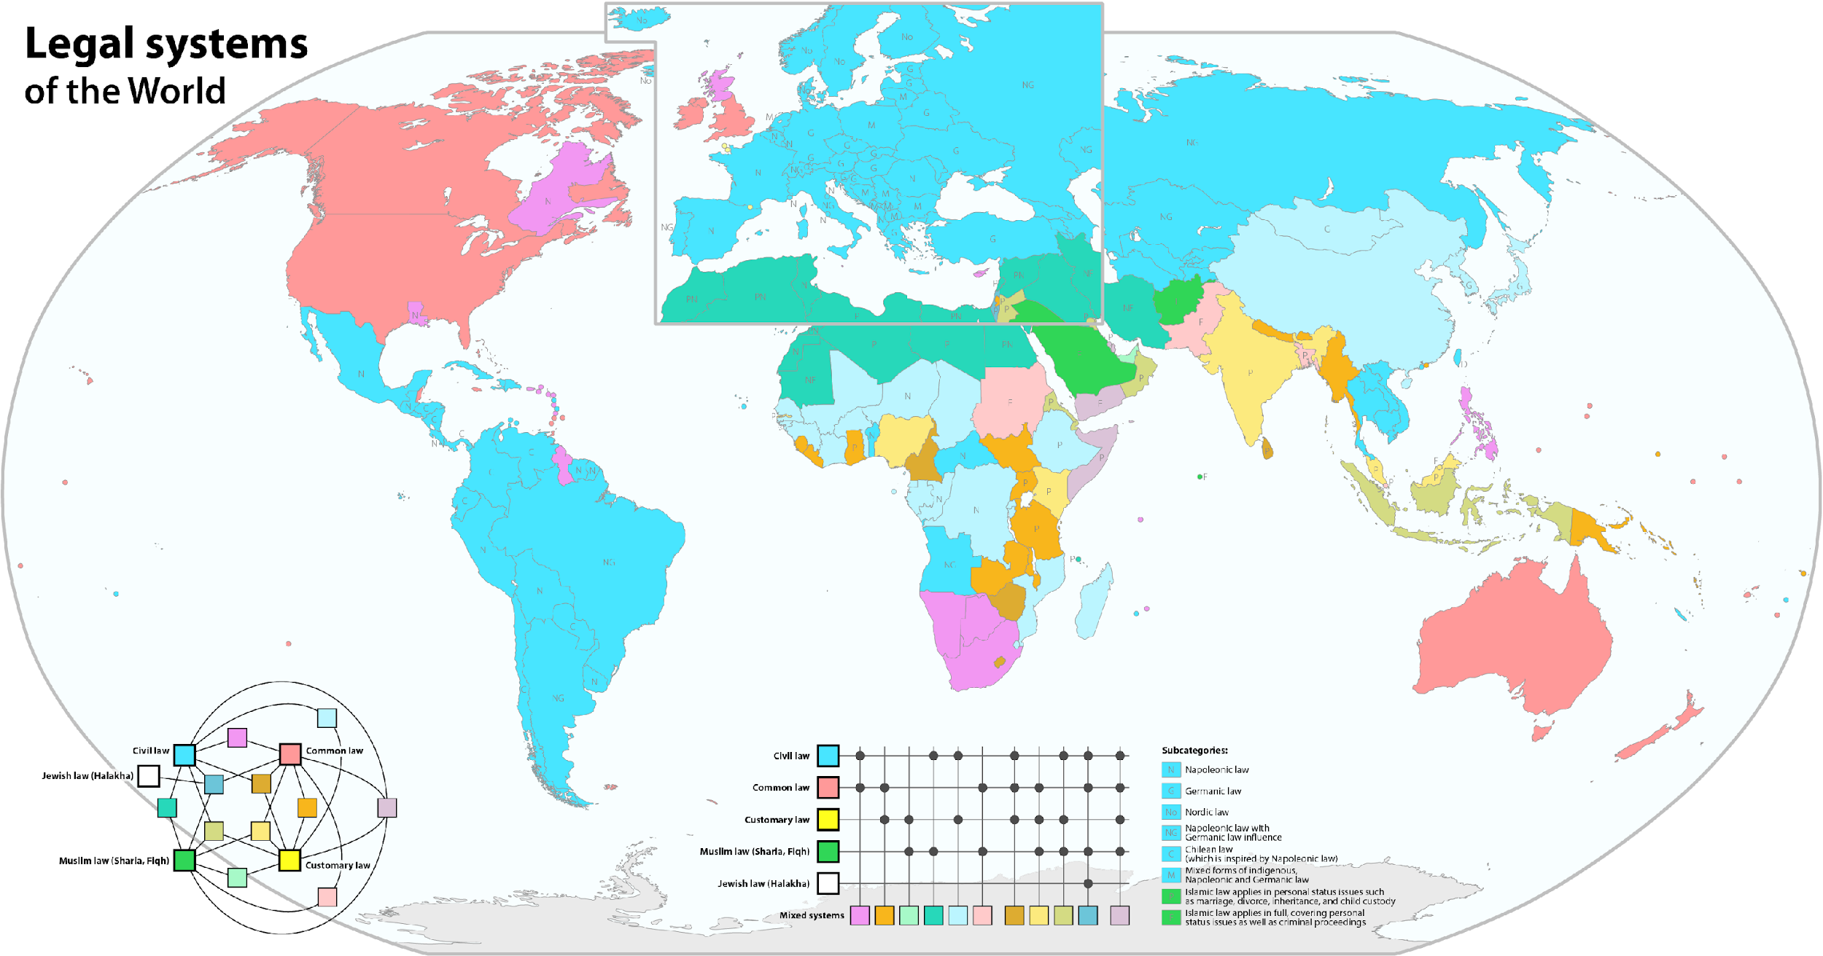
Notes:
Common -- historical
Equity -- A body of civil law concerned with doing justice where money is inadequate or inappropriate as a remedy. Examples of equitable actions include divorce and injunctions. Equity cases are handled by circuit courts. (Originally, a King's corrective prerogative, justice administered according to ideas of fairness, not strict adherence to precedent / stare decisis )

Slide 38
1.4 Case Example
Let’s follow a hypothetical case
to get an idea of procedure
and terminology
Notes:
Freddie / Balt

Slide 39


The course of a lawsuit
Smith sues Jones
The initial complaint is called Smith v Jones. It is filed in the office of the clerk of the circuit court and papers are served on the respondent.
Preliminary motions are filed (motion to dismiss, demurrer, change of venue)
Trial date is set, attorneys start discovery process; jury is empaneled (voir dire) and judge instructs jury on law
Trial is held, evidence weighed, verdict given. Smith wins
Notes:
Tests: Preponderance of evidence; Preferred Position

Slide 40
The course of a lawsuit 2
Appeal: Jones sues Smith
Now the suit is called Jones v Smith
Appeals court reads briefs, hears oral arguments, Jones wins, appeals court decides to remand to lower court
But Smith appeals to the Supreme Court

Slide 41
The course of a lawsuit 3
Appeal: Smith sues Jones
Now the suit is called Smith v Jones again
The Supreme Court grants certiorari, reads the briefs, hears oral arguments, and later issues an opinion in the case.
Jones wins again. Smith has nowhere else to go.
There are several dissenting opinions issued by judges who think Smith should have won. But Smith v Jones is now an established precedent.

Slide 42
1.5 Principles of Democracy
The operating principles of a democracy include:
Popular sovereignty
Natural rights
Equal justice under law
Due process of law
Constitutionality
Separation of powers
Federal supremacy
Stare decisis
Majority rule with minority rights
Marketplace of ideas
Liberty / Freedom

Slide 43
Legal terms & concepts
Internal principles of the law and legal systems, especially equal justice under law, stare decisis, and due process.
External issues involving the interaction between the law and social institutions within a larger context. We may be concerned, for example, with questions such as the “original intent” of the framers of the Constitution, as opposed to the idea of a “living constitution” in which definitions of human rights may expand to meet new social conditions.
Notes:
as was Justice Anthony Kennedy (in July, 2015),

Slide 44
Legal terms & concepts
Equal Justice and the Rule of Law -- This is an ancient concept and one of the most important and hard-fought ideas in human history. The principle is that no one — not even a king — is above the law.
Due Process of law -- Respect for individual rights through legal procedures originated in the Magna Carta of 1215. Due process for all American citizens is the main point of the 14th Amendment.
Constitutionality – The requirement that a law is in harmony with the Constitution.
Stare decisis -- Let the precedent stand. (Respect prior court decisions)
Notes:
Many wars and revolutions have been fought to preserve and extend the basic idea of equal justice, as we will see when we consider the history of free speech.
From the Constitutional point of view, the “law” is not just a set of rules that can easily be consulted. New circumstances require new interpretations all the time. But there are ongoing debates about this concept. Conservative scholars see a need to base Constitutional law on the “original intent” of the framers of the Constitution in 1789. Liberal scholars see the Constitution as a “living document” that can and should change with the times. Debates between these two schools of thought have underpinned questions about the rights of minority groups and free speech issues for many decades.
RE Const -- In the area of human rights law, for example, this concept might involve the protection of rights by the Bill of Rights (in the US) or the European Convention on Human Rights (in Europe). Also, in countries without a constitution, or without a constitutional guarantee of human rights, the United Nations Declaration of Human Rights may be invoked.
Example: In New York Times v Sullivan, 1964, the Supreme Court said that if it were to decide the case against the New York Times, and make it easy for public officials to sue the press for defamation (libel), then the court would be undermining the First Amendment of the US Constitution.

Slide 45
Legal concepts – Supremacy
Federal supremacy — Federal law is superior to state law: The Supremacy clause in U.S. Constitution (Article 6 ) means that states are bound by the U.S. Constitution, federal law and federal agency regulations.
Fourteenth Amendment (passed in 1868) makes the US Bill of Rights applicable to the states. However, this did not happen all at once. Instead, a very gradual process called Constitutional Incorporation took place.
Notes:
Stare decisis This is a key component of the common law system that provides stability and predictability by relying on precedents to guide opinions. Judges usually go by the precedent unless there is a reason to overturn it.
Example: when asked about Roe v Wade (the major abortion decision from 1973), many of the candidates for Supreme Court in recent years said they were personally opposed to abortion but that the principle of stare decisis was more important.

Slide 46
1.6 Distinguishing media law
What distinguishes media law?
Civil law cases
Content issues – Constitutional law, some statutory law
Structural issues – Regulatory law through FCC regulations, anti-trust
Notes:
Freddie / Balt

Slide 47
1st Amendment Constitutional law, Censorship, libel, privacy, commercial speech, social media
(content issues)
Media regulation Advertising content, anti-trust & broadcasting structure
Entertainment law, copyright, contracts etc. (structural issues)
Notes:
Overlapping areas of media law

Slide 48
What distinguishes media law?
Content issues
are usually between a plaintiff and a respondent.
-- In the US, content issues usually involve Constitutional law and common law.
Prior restraint, libel, invasion of privacy, and obscenity are content issues tried in civil courts
Structural issues - Copyright and some broadcasting content issues are governed by statutory and regulatory law.

Slide 49
Criminal vs civil procedure
Criminal charges or indictment brought by police or prosecutor
Penalties in criminal law range from small fines to jail terms /execution
Almost all media law is civil (not criminal)
Exception: public relations misrepresentations of medical or securities information
Civil law (note different meaning here) involves lawsuits between individuals
Penalties include fines and sometimes remedial action, but never jail

Slide 50
What distinguishes media law?
Media law emerges from a large and complex historical tradition of the struggle first for religious and next for political freedoms.
Tests applied in media law content cases give a strong "preferred position" to individual liberty of speech as protected by the First Amendment to the US Constitution. However, tests applied in structure cases use a standard "preponderance of evidence" test. "Guilt beyond a reasonable doubt" is only used in criminal cases as part of the Sixth Amendment guarantee of a fair trial.

Slide 51
US media content regulation
Type | Content | Resolved by …
All media | Sedition, criticism govt, leaking documents | Mostly legal - High burden of proof
All media but broadcasting | Obscenity | No longer illegal (but not protected by 1st Amendment)
All media | Libel, slander | Private civil lawsuits
All media | Privacy, intrusion, | Private civil lawsuits
All media | Copyright | Private lawsuits, Bern Convention, US LofC
Advertising | Products & services | FTC, FDA, FCC
Broadcasting | Obscenity, indecency | FCC
Broadcasting | Ads aimed at children | FCC

Slide 52
US media structural regulation
Type | Structure | Resolved by …
Print ownership | Antitrust laws | Legislation (Congress)
Radio, TV ownership | Bcast ownership rules, Antitrust laws | FCC, Legislation (Congress)
Broadcast cable satellite TV | Technical standards | FCC, ITU (international)
Satellites | Technical standards | ITU (MPEG, JPEG, others)
Internet and web | Domain names, technical issues | ICANN, ITU

Slide 53
Concepts & terms
1.7 Tests & Doctrines
This is a very general introduction to some legal terms and important concepts that we’ll use throughout the semewster.
You’re probably familiar with many of them, such as the standard (or burden) of proof test in a criminal case ...
Notes:
Freddie / Balt

Slide 54
State action doctrine
The First Amendment protects people from censorship by any government (or state) actor, but not from private non-state actors.
The First Amendment says “Congress shall make no law … abridging the freedom of speech, or of the press.” This applies to government action but not to private editorial decisions.

Slide 55
Burden of Proof
In a criminal case, innocence is assumed until guilt beyond a reasonable doubt is proven.
In a civil case, the standard is the preponderance of evidence, (51% vs 49%)
However, in Constitutional cases, we apply strict or intermediate scrutiny tests to be applied.

Slide 56
Scrutiny:
3 tests for constitutionality
When courts review laws that curtail constitutionally protected rights, they first determine the level of scrutiny to be applied
Strict scrutiny - specific content regulated
Intermediate scrutiny - content neutral regulation
Rational basis review – routine non-Constitutional regulation
Notes:
Strict – Example – child pornography not protected; threats to life of president /// Intermediate Examples – Time, place and manner restrictions are often used for content-neutral items: FCC v Pacifica (the Carlin “safe harbor” decision); Ward v. Rock against racism (loud concerts could be controlled by NY city audio technicians);
Also as in NAACP v Alabama (Patterson) 1958, even supposedly content neutral business regulations on out of state organizations can be tested and found wanting; or Romer v Evans 1996, a Colorado law designed to punish a politically unpopular group was struck down by the courts.
“Heightened scrutiny” also used for some types of cases involving kinds of people who have not been historically privileged

Slide 57
Rational basis review
Most lenient test for a law
Government only has to show that a law has a legitimate interest that is rational and non-arbitrary
Generally used when fundamental rights or suspect classifications are not at issue
= groups of people who have been historically discriminated against.

Slide 58
Intermediate Scrutiny
A law affecting freedom of speech must
1) be within power of government;
2) advance an important gov’t interest;
3) be narrowly tailored, not overly broad
4) leave open alternative options for communication
Time, place & manner restrictions are an option under intermedia scrutiny

Slide 59
Intermediate Scrutiny
Ex: Central Hudson v NY PUC 1980
1) Legal? (Yes, advertising) 2) Important government interest? (Yes, save energy) 3) Further the interest? (No, advertising doesn’t necessarily mean energy waste) 4) Narrowly tailored? (No, its overly broad; it affects all company speech in one narrow interest)
Notes:
There are lots of similar tests in law. Most foundational cases provide a test or a set of standards.

Slide 60
Strict Scrutiny
When a law infringes on a fundamental constitutional right, and regulates the content or subject of a message, it is subject to strict scrutiny review.
So the courts ask, is the law … 1) Justified by a compelling government interest? 2) Does it further the interest?
3) Narrowly tailored?
4) Least restrictive
Notes:
There are lots of similar tests in law. Most foundational cases provide a test or a set of standards.

Slide 61
Strict Scrutiny
Ex: Reed v Town of Gilbert (2015) Clyde Reed, pastor of a church, placed temporary signs in Gilbert, Az advertising services. This violated a town ordinance that placed more restrictions on temporary directional & religious signs than political signs. So, was there a compelling government interest regulating temporary signs in Gilbert?
Notes:
There are lots of similar tests in law. Most foundational cases provide a test or a set of standards.

Slide 62
Strict Scrutiny
Ex: Reed v Town of Gilbert (2015) Justice Clarence Thomas (writing the opinion for the majority) held that the content-based restrictions that did not survive strict scrutiny because the ordinance was not narrowly tailored to further a compelling government interest.
Notes:
There are lots of similar tests in law. Most foundational cases provide a test or a set of standards.

Slide 63
Legal terms – Overbreadth
If a law is vague, or can be selectively administered, it may violate Constitutional rights.
A good law is not overly broad, but rather, is narrowly tailored to meet compelling interests.
In US v Stevens, 2010, the Supreme Court said that a law banning videos depicting cruelty to animals was overly broad and should have been more narrowly tailored. Although the intent of the law was good, the way the law was written could have led to problems.

Slide 64
Legal terms – Forum
Public forum –
Parks, streets, traditional areas for free speech
No content restrictions
Limited time place manner restrictions
Limited purpose public forum
City council, university lecture halls
Time, place, manner restrictions allowed
Need not be least restrictive
Non- public forum.
Military bases, airports, private property
Content based restrictions OK
Notes:
So for example public park may be closed at dark, reasonable restriction. Cant restrict content of speech, or viewpoint. EG cant say no political pamphlets, and certainly cant say no Republican pamphlets;

Slide 65
Legal terms - civil law
Brief, certiorari, concur, demurrer, discovery, dissent, distinguish, ex parte, injunction, interrogatories, motion, opinion, petitioner (plaintiff), quash, remand, reverse, respondent (defendant), subpoena duces tecum, summary judgment, stare decisis, tort, uphold, venue, voir dire

Slide 66
1.8 Jurisprudence
What do we think that the law should do? Normative approach to law
Jurisprudence is the broad term for the history, theory and philosophy of law. It is where questions about the purpose of law are addressed.
Used in a sentence, you might say that a certain decision was important in First Amendment jurisprudence, or that a lawyer’s grasp of jurisprudence was legendary.
Notes:
Freddie / Balt

Slide 67
Issues in Jurisprudence
Should the government regulate political speech (and money) in elections, or should anyone be allowed to participate in any way they like? Is spending money in itself a form of free speech?
Should the law protect national symbols (eg, the American flag), or should the law protect a deeper principle in protecting the right to burn a flag?
Should the law protect the reputations of public people, or should the law protect the ability to criticize public people? And who is public?
Should the law boost civic virtue (and how can we be sure what that is), or should the law facilitate individualism (and what limits, if any, should there be)?
Should the law enhance copyright protections or should it enlarge the public domain?
How do we measure the equity and effectiveness of the law?

Slide 68
1st Amendment Jurisprudence
Debate about freedom of religion, press, speech, assembly and petition is constant constant in most civilizations. We’ll look at this in Section 3 (history.
In the US, the underlying theory of a federal First Amendment law doesn’t start to take shape until the 1920s, as part of the Constitutional incorporation process of the US Bill of Rights ( the first ten amendments to the US Constitution).
Incorporation was the process under which state law was subordinated to federal law after the US Civil War.
First Amendment jurisprudence (religion, press, free speech, etc.) involved state laws until the World War I era.
Remember, “Congress shall make no law…” didn’t mean that state legislatures could not make law, at least, before the incorporation process.

Slide 69
1st Amendment Theories
Balancing — Zechariah Chafee wrote his foundational book Freedom of Speech (1920) in the context of the WWI Sedition Act, the anti-Red “Palmer Raids” by the attorney general and especially the Schenck v US ‘clear and present danger’ decision of 1919, which he found ill-advised.

Slide 70
1st Amendment Theories
Absolute protection for free speech — Alexander Meiklejohn argued that nothing is more important to a democracy than freedom of speech. For example, see Free Speech and its Relation to Self-Government, 1948.

Slide 71
1st Amendment Theories
Libertarianism — Action vs Expression — Thomas I. Emerson The underlying theory of the First Amendment should distinguish between action and expression. Also, freedom of expression includes the right to form and hold beliefs on any subject and to communicate those beliefs to others by whatever medium, along with the right to hear the opinions of others, and the right to inquire, to have reasonable freedom of access to information

Slide 72
1st Amendment Theories
Context — Franklyn S. Haiman – Trying to distinguish between expression and action causes more harm than good, Haiman argues. All expression and action is in effect communication. It’s the context, the potential for harm, that the law has to consider.

Slide 73
1st Amendment Theories
Social Justice — Robert W. McChesney — The New Theology of the First Amendment, Monthly Review, March 1, 1998. — McChesney discusses freedom of speech in the context of corporate and commercial intrusion on political speech issues.
If the rights to be protected by the First Amendment can only be effectively employed by a fraction of the citizenry, and their exercise of these rights gives them undue political power and undermines the ability of the balance of the citizenry to exercise the same rights and/or other constitutional rights, then it is not necessarily legitimately protected by the First Amendment.”

Slide 74
1st Amendment Theories
“Code” versus law — Lawrence Lessig Digital media is already balanced between the a) code of laws written by elected officials and, b) the computer code written by digital media companies who structure the media experience.
Individuals are regulated by four forces: the law, social norms, the market, and architecture (technical infrastructure).

Slide 75
1st Amendment Theories
Human Dignity law
The marketplace of ideas is broken. It cannot correct false, harmful and hateful speech due, in part, to the complexities of new media.
Karl Popper’s Paradox of Tolerance – A society can be too tolerant. It can open the door to its own destruction by being overly tolerant to destructive ideas.

Slide 76
Jurisprudence and Constitutional interpretation
Originalist (very conservative)
Literalist (conservative)
Modernist (liberal)
Instrumentalist (very liberal)

Slide 77
Jurisprudence and Constitutional interpretation 1
Originalist / Original Intent
Interpret the Constitution to mean what the framers intended it to mean at the time. The Constitution is a legal document, they argue. It's a contract. Originalists often refer to the Federalist Papers and other contemporary writings to understand the original meaning of the Constitution. (Antonin Scalia and Clarence Thomas)

Slide 78
Jurisprudence and Constitutional interpretation 2
Literalist / Strict Constructionist
Strict constructionists read the law according to the literal definitions of the words involved. They do not try to infer the Framers' intent behind the words, but stick to the meanings of the actual words used.
( John Roberts, William Rehnquist)

Slide 79
Jurisprudence and Constitutional interpretation 3
Modernist / Living Constitution The Constitution is a "living" document. As civilization changes, the Constitution may also need to change with times. The Framers had no ability to foresee the needs of the future. Judges have the responsibility to "fill in the gaps." Courts may strike down laws that restrict fundamental human rights.

Slide 80
Jurisprudence and Constitutional interpretation 4
Instrumentalist / Living Constitution
Apply the Constitution in the way that is most practical for contemporary society, regardless of the original intent of the document or strict definitions of its words.
(John Paul Stevens, David Hackett Souter, Ruth Bader Ginsburg and Stephen Breyer)

Slide 81
1.9 Int’l Comm Law
Involves treaties, conferences, conventions, declarations, and other kinds of negotiated agreements, often administered through international organizations, particularly the United Nations and its many Special Agencies.
More on this in Section 2, ethical issues
International Comm Tech ethics

Slide 82
UDHR is basic document
International communications law is based on the Universal Declaration of Human Rights. Article 19, which says:
Everyone has the right to freedom of opinion and expression; this right includes freedom to hold opinions without interference and to seek, receive and impart information and ideas through any media and regardless of frontiers.

Slide 83
Int’l Comm Agencies
The International Telecommunications Union – A UN special agency that focuses on radio communication, standardization, and development of telecommunication networks. Most people are familiar with two of their ongoing standards projects, the Joint Photographic Experts Group (jpg) and the Moving Picture Experts Group (mp4).
World Intellectual Property Organization – A UN special agency that administers copyright and other IP treaties, especially the Berne Copyright Convention.
Universal Postal Union – A forum for international cooperation for postal services
ICANN (Internet Corporation for Assigned Names and Numbers) – an independent non-profit organization that coordinates the Internet’s unique identifiers, originally established with U.S. government oversight but now independent, operating under its own international community model. ICANN regulates web domain names and resolves disputes.
UNESCO – UN educational, scientific and cultural organization founded in 1946 to promote ideas of peace and progress.

Slide 84
Thank you

